Slide 1

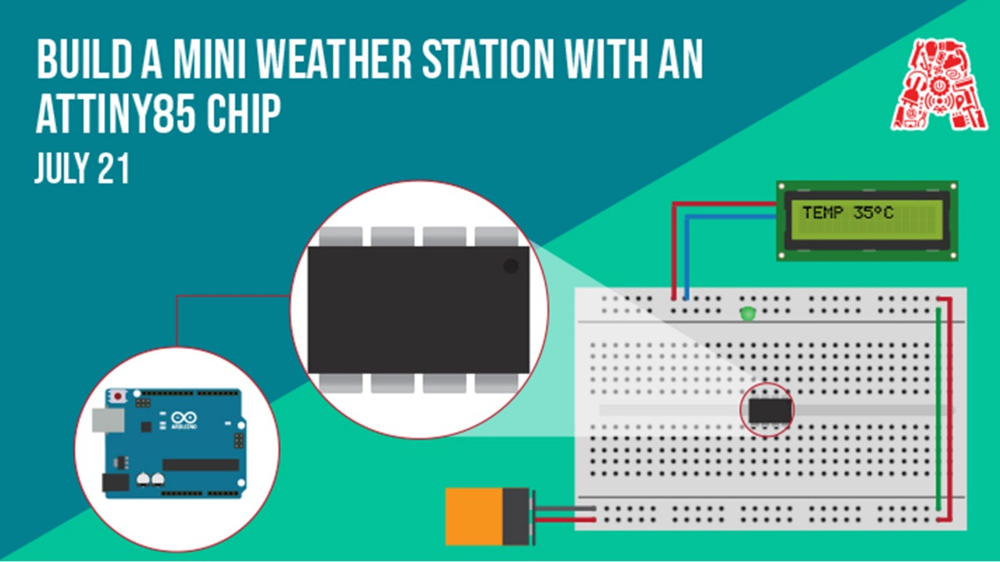

Slide 2
Agenda
Programs you need to install Arduino IDE
Introduction to ATtiny and its various application
Simple LED example with the ATTiny85
Making a scaled down version of weather station
Working with temperature sensors and OLED screens

Slide 3
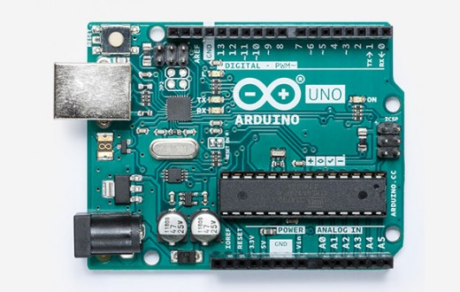
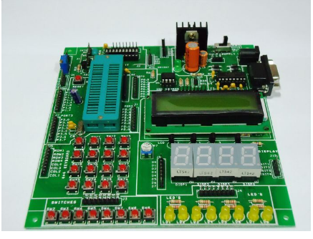
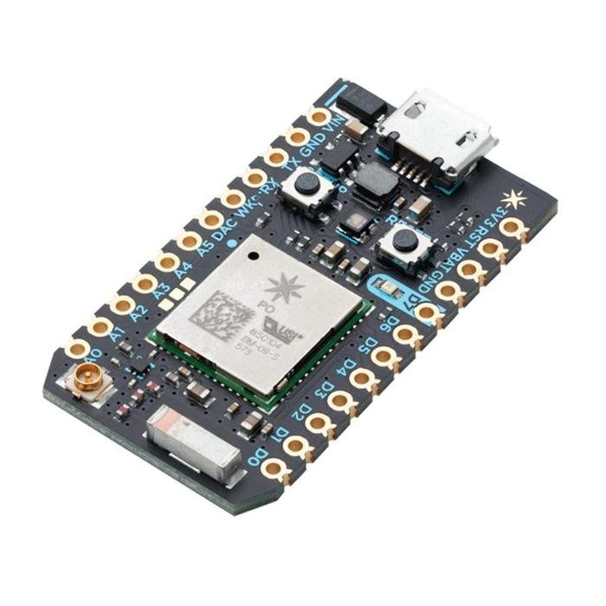
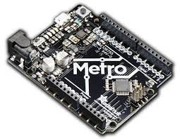
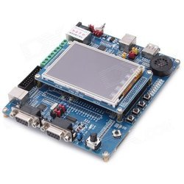
Why use ATtiny chips?

Slide 4
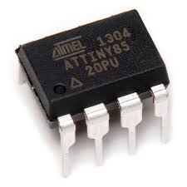
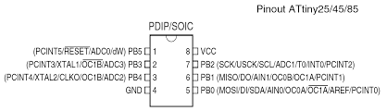
ATtiny85

Slide 5
Arduino UNO

Slide 6
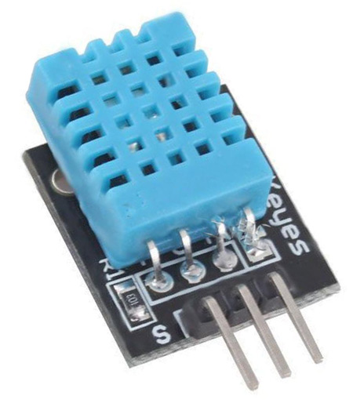
Temperature Sensor DHT11

Slide 7
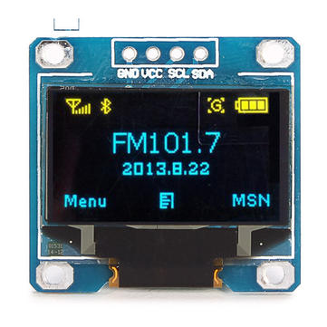
OLED screen display

Slide 8
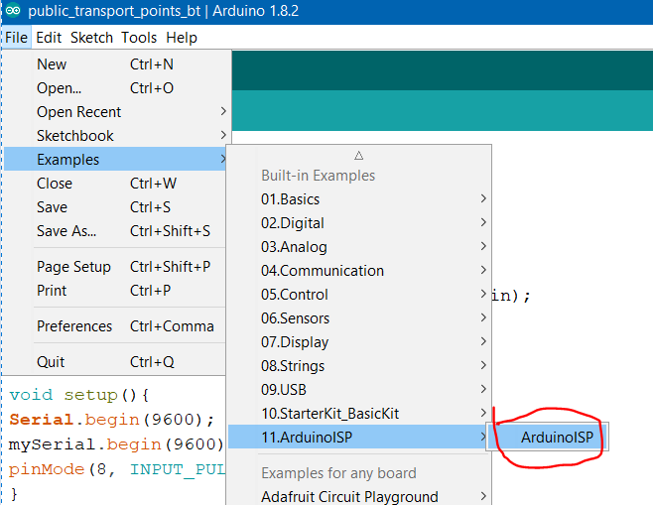
Live demo: Setup Bootloader
Open the Sketch “ArduinoISP” from the File, Examples and ArduinoISP menus.
Verify and upload this sketch to your Arduino

Slide 9
Live demo: Setup Bootloader
The Arduino software does not natively support the ATtiny85 so we need to add support for it.
Open the Preferences Dialog from the File menu.
Put https://raw.githubusercontent.com/damellis/attiny/ide-1.6.x-boards-manager/package_damellis_attiny_index.json into the "Additional Boards Manager URL".
Click OK!

Slide 10
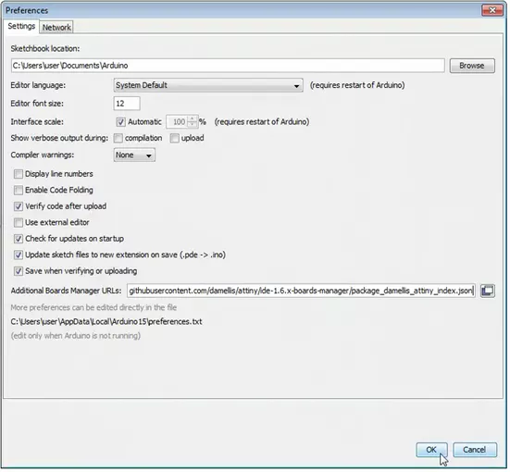

Slide 11
Live demo: Setup Bootloader
Open the Boards Manager from the Tools, Board Menus
Select the ATtiny from the list once the software has updated
Search for ATtiny, either manually scrolling down the list, or typing "attiny" in the filter field.
Click Install the (Use the latest version).
Install the following 2 libraries:
https://github.com/datacute/Tiny4kOLED
https://github.com/adafruit/TinyWireM

Slide 12
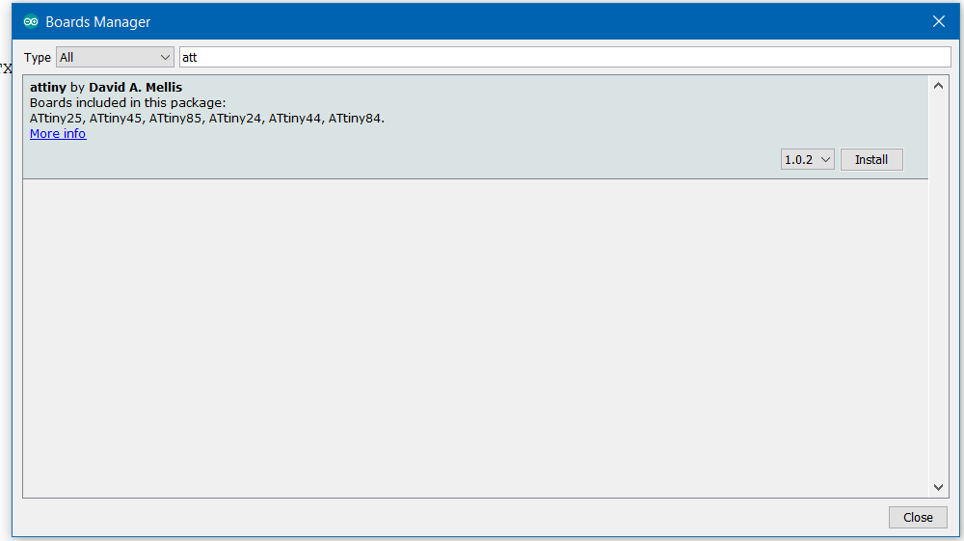

Slide 13
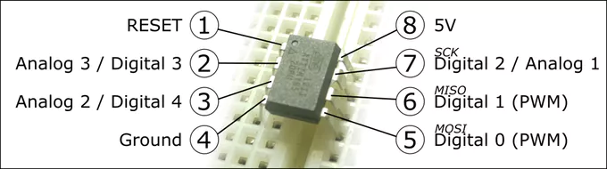
Program Setup
Program Setup
Let’s set up the program to use the Arduino as a programmer.
Select Arduino as ISP from the Tools, Programmer Menus
Select ATtiny from the Tools, Board Menus
Select ATtiny85 from the Tools, Processor Menus
Select 8Mhz Internal from the Tools, Clock Menu

Slide 14
Hardware Setup
Unplug your Arduino
Place the ATtiny Chip onto the breadboard
Connect the ground from the Arduino to the Ground Rail
Connect the 5V from the Arduino to pin 8 of the ATTINY
Connect pin 4 of the chip to ground
Place the capacitor between ground and another terminal strip (The anode of the capacitor must be connected to ground)

Slide 15
Hardware Setup
Connect the cathode of the capacitor to the Reset pin of the Arduino
Connect a lead from the header pin 10 of the Arduino to pin 1 of the chip
Connect Arduino Pin 11 to Pin 5 of the chip
Connect Arduino Pin 12 to Pin 6 of the chip and
Connect Arduino Pin 13 to Pin 7 of the ATtiny85

Slide 16
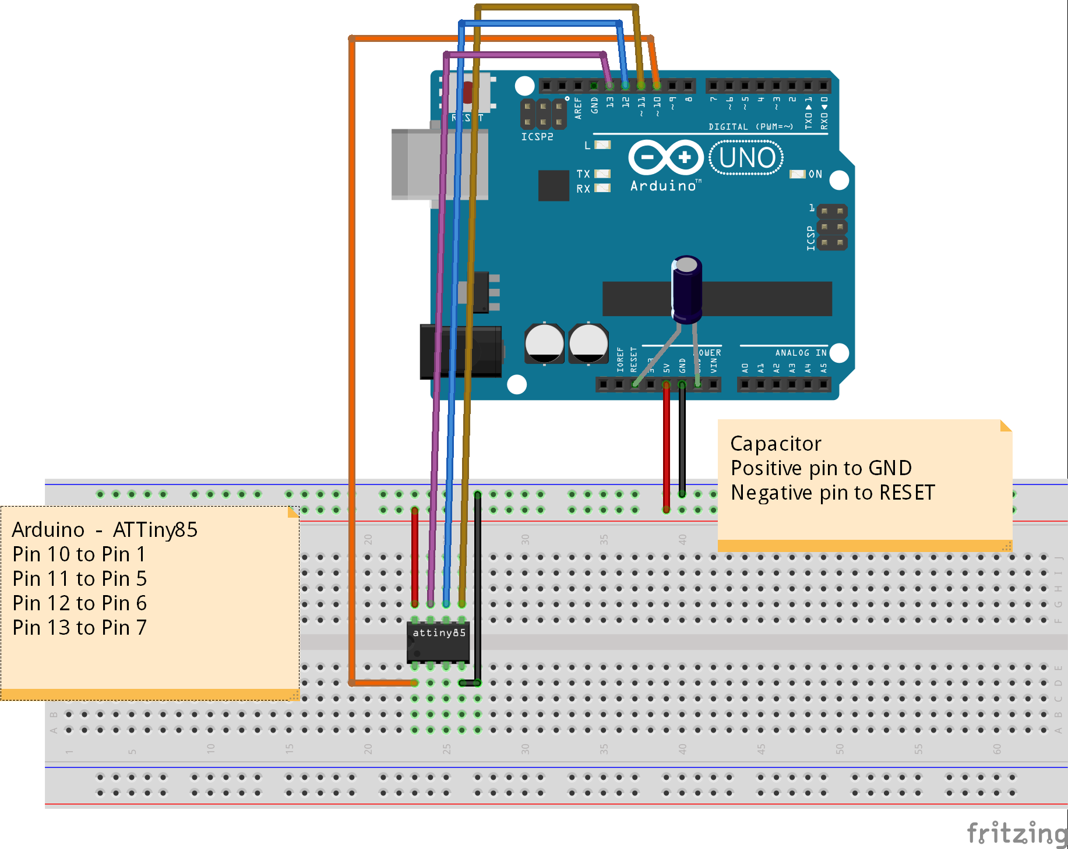

Slide 17
void setup() { pinMode(4, OUTPUT);
}
void loop() { digitalWrite(4, HIGH);
delay(1000);
digitalWrite(4, LOW);
delay(1000); }
Burn the blink code to the Attiny85 in order to insure that its working fine.

Slide 18
Attach the OLED & DHT11
Connect SDA pin to 5
Connect SCL to pin 7
Connect VCC and GND to +5V and GND on power source
Attach the DHT to the pin 2 of Attiny.
Once that is done, you can upload Arduino Sketches to the ATtiny chip, as if it were an Arduino.

Slide 19
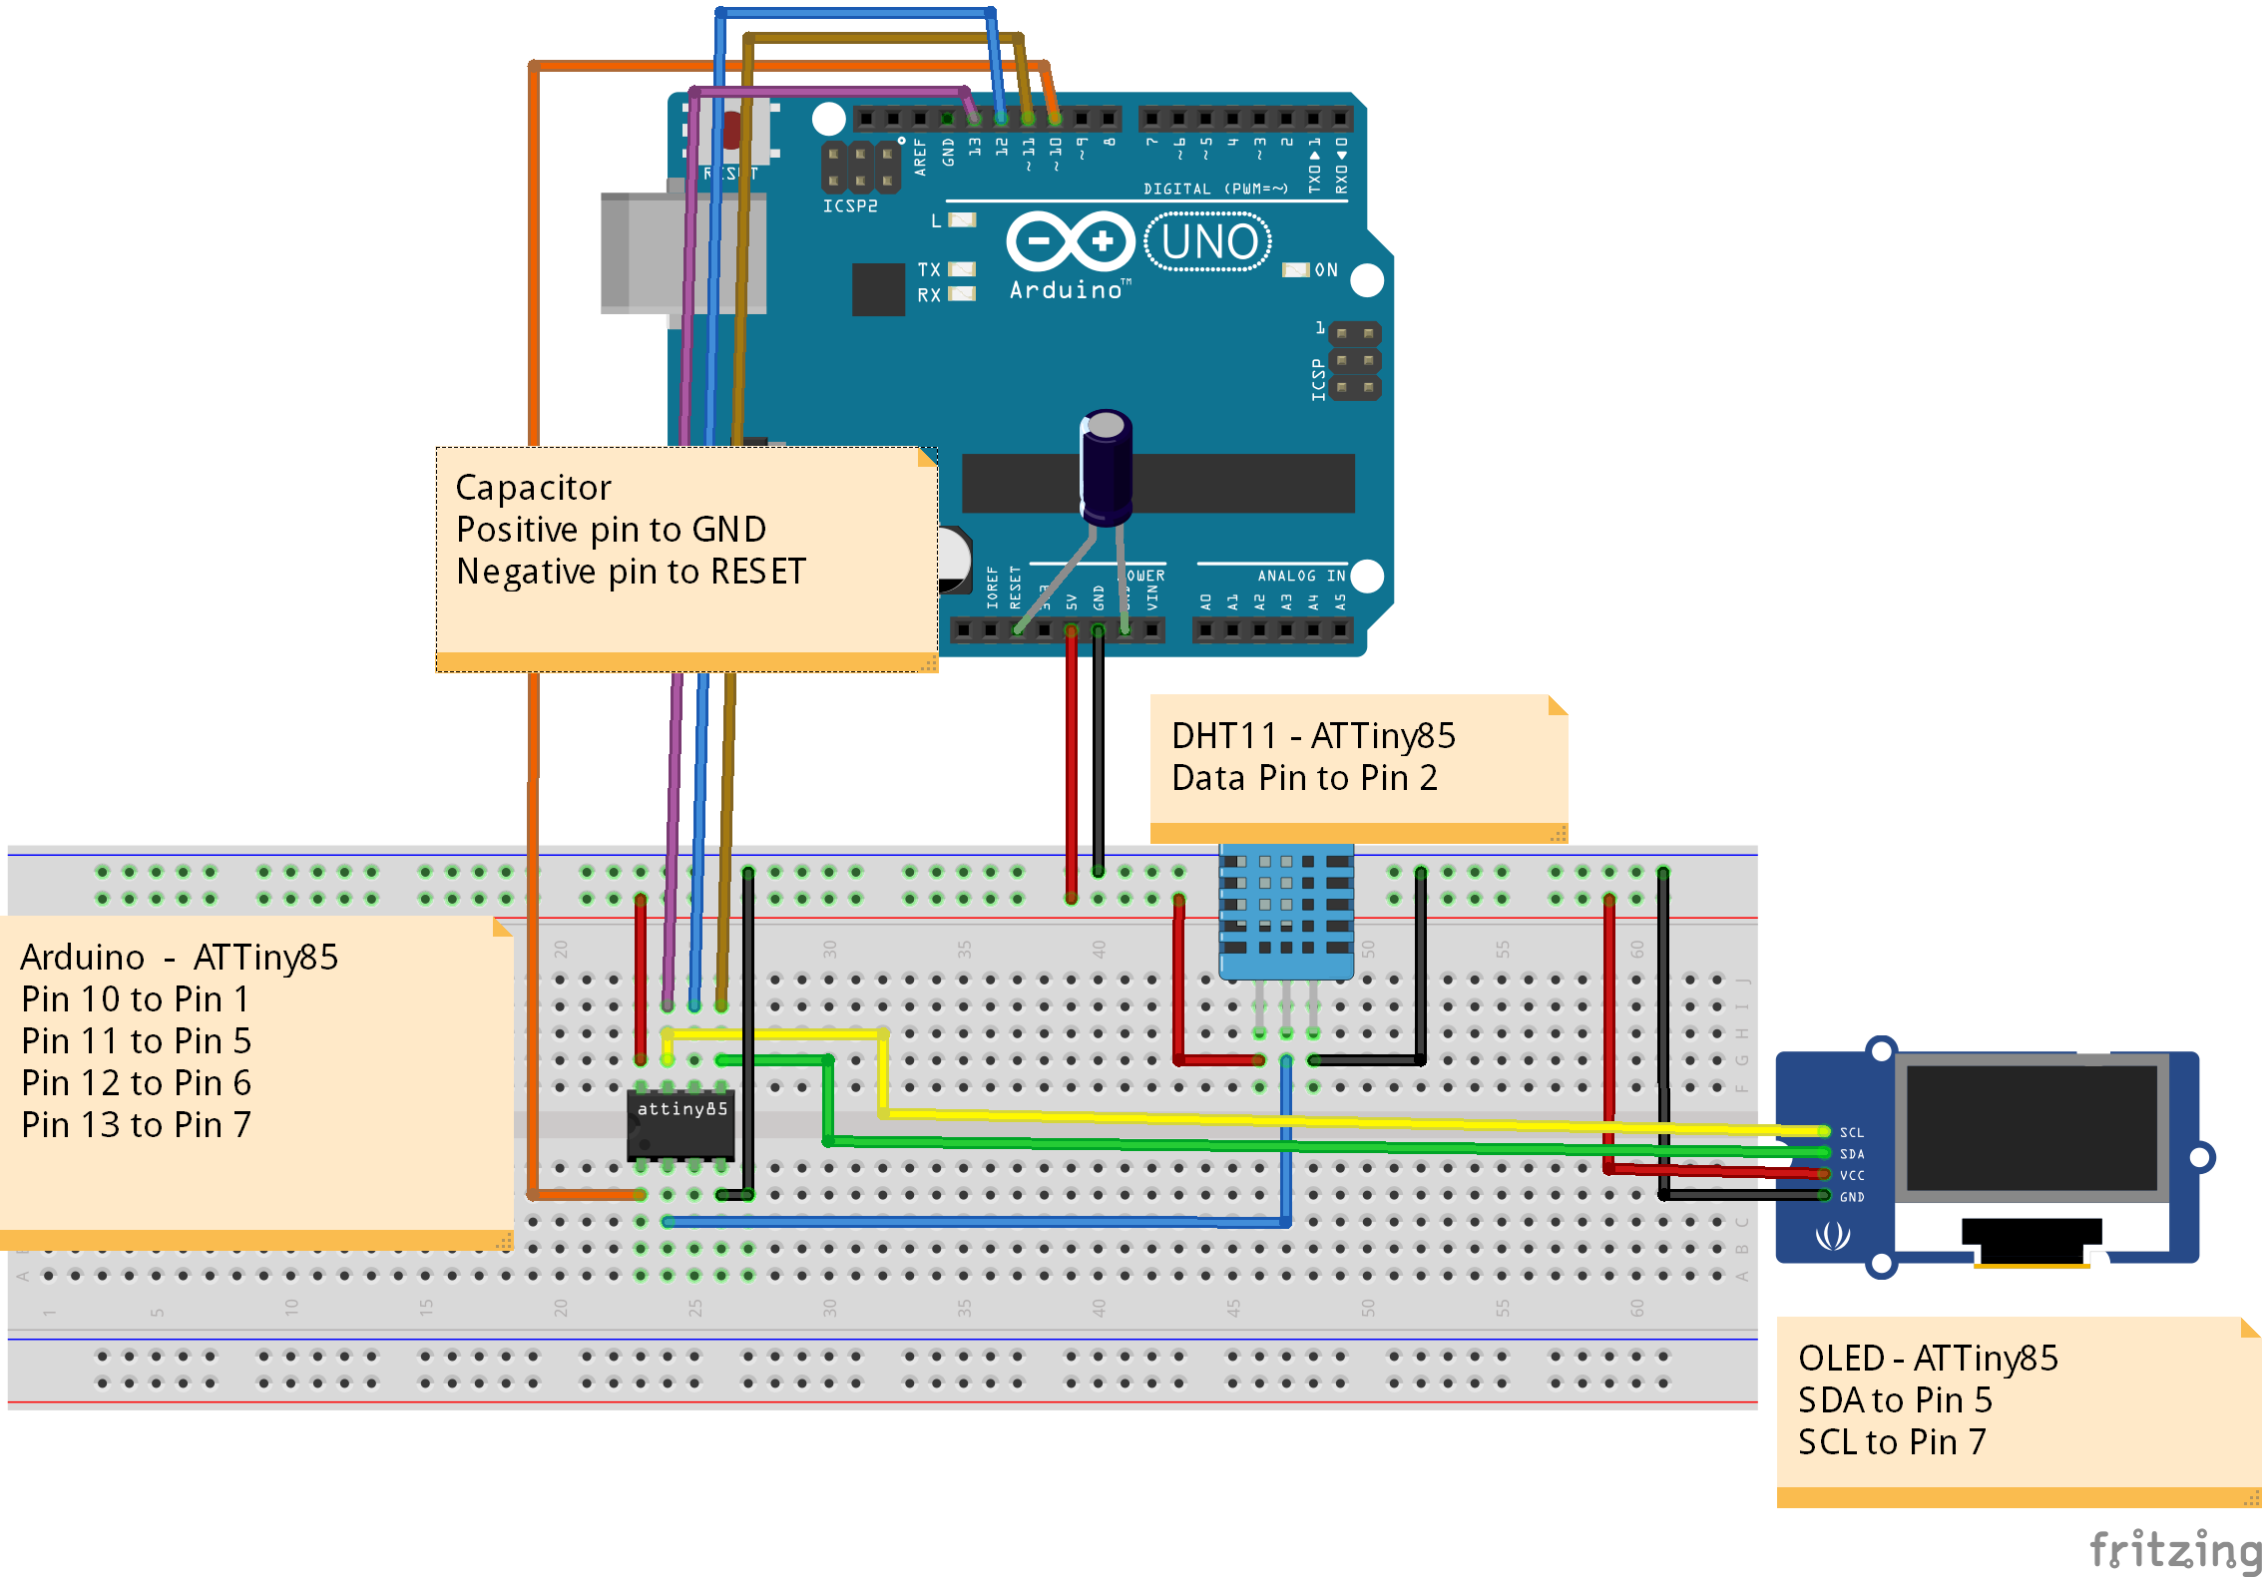

Slide 20
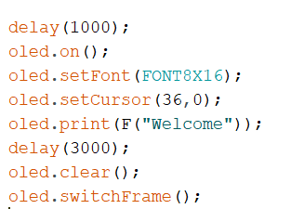
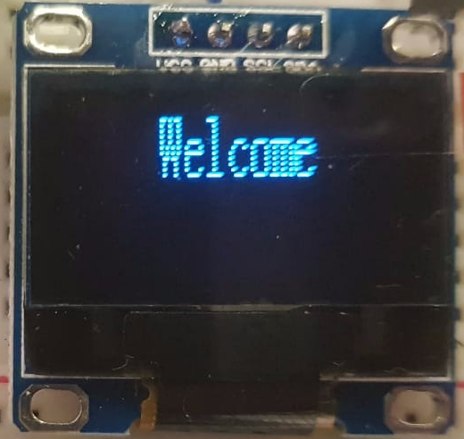
Welcome

Slide 21
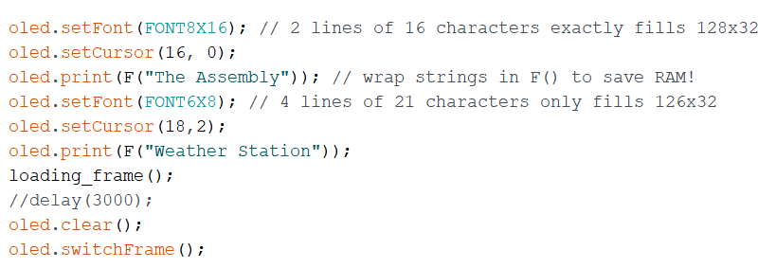
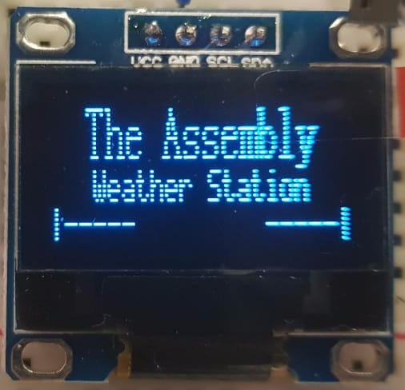
The Assembly Weather Station

Slide 22
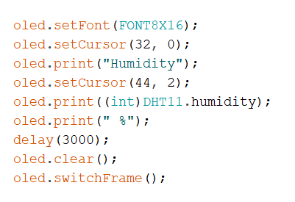
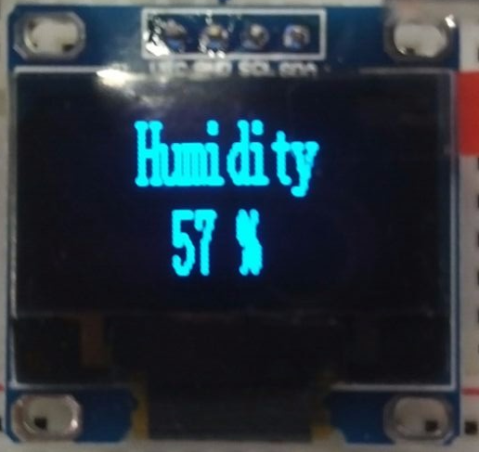
Humidity displayed on the OLED screen

Slide 23
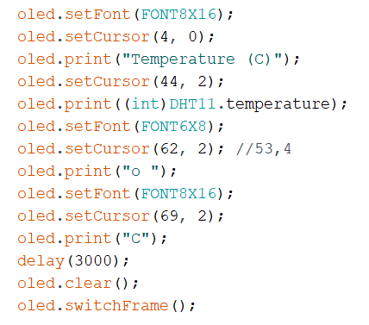
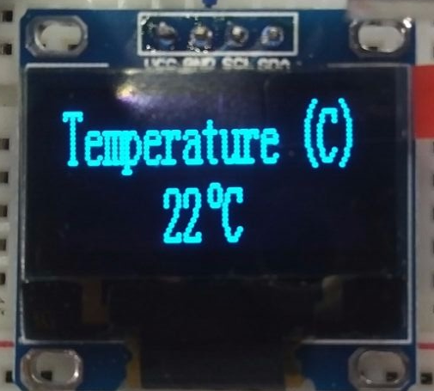
Temperature(°C) displayed on the OLED screen

Slide 24
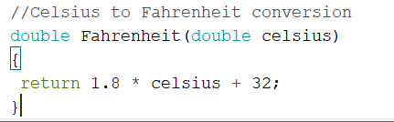
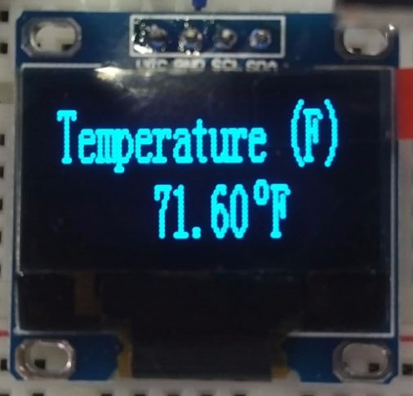
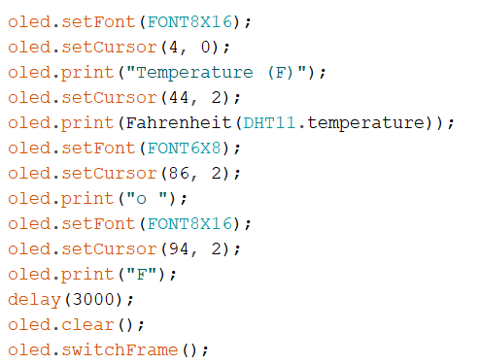
Temperature(°F) displayed on the OLED screen

Slide 25
Thank You!

